Slide 1

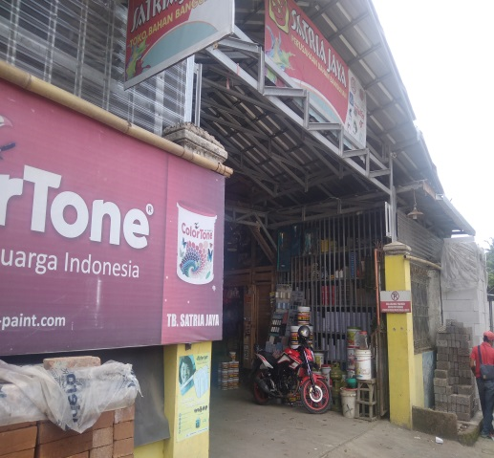

APLIKASI PENJUALAN BARANG BAHAN BANGUNAN POIN OF SALE
TOKO BANGUNAN SATRIA JAYA
HARIS ANWAR
5520118042

Slide 2
TOPIK PEMBAHASAN
Tempat penelitian
Latar Belakan & Rumusan Masalah
Maksud, Tujuan, dan Batasa Masalah
Metode Penelitian,sistem yang berjalan
Kesimpulan Dan Saran
UML

Slide 3

Tempat Penelitian
1. Nama Instansi
TOKO SATRIA JAYA
01
2. Alamat
Jl.Aria Wiratanudatar KM.5 Sindanglaka, WA:0878 2030 2023,
Kabupaten Cianjur, Jawa Barat
02
3. Bidang Usaha
Bidang usaha penjualan, product bahan bangunan
03
4. Sejarah singkat
04
Dari induk Toko Bapak Fakih tahun 1960 pemilik Bapak H. Fakih.
Tahun 2007 Berdiri Toko Satria Jaya Pendiri Bapak Haji Deden (Cucu dari dari Bapak Haji Fakih), yang menjual bahan bangunan seperti kayu, bata, besi, semen, cat, paku, pasir, kramik, dan lain-lain.
Kembali

Slide 4

Latar Belakang
Pada Toko Satria Jaya, perhitungan data barang secara manual menimbulkan ketidak efektifan dalam pengecekan kembali barang, begitu pun penjualan barang secara manual yang seringkali menimbulkan ketidakpastian terhadap customer, kepuasan konsumen selalu menjadi nomor satu bagi toko, terutama toko yang bergerak di bidang perdagangan.
Mengenai hal tersebut tentunya pemanfaatan teknologi komputer sangat dibutuhkan di berbagai bidang, terutama bidang perdagangan dimana setiap barang masuk dan barang keluar dapat dinput secara komputerisasi, selama ini bidang usaha Toko Bangunan Satria Jaya, masih menggunakan tulis tangan, baik dalam pencatatan penjualan kepada konsumen ataupun pendataan barang bahan bangunan.

Slide 5
l
Rumusan Masalah
1. Bagaimana membuat sistem yang dapat mengelola barang masuk dan barang keluar ?
2. Bagaimana membuat sistem penjualan barang dengan komputerisasi ?
Kembali

Slide 6
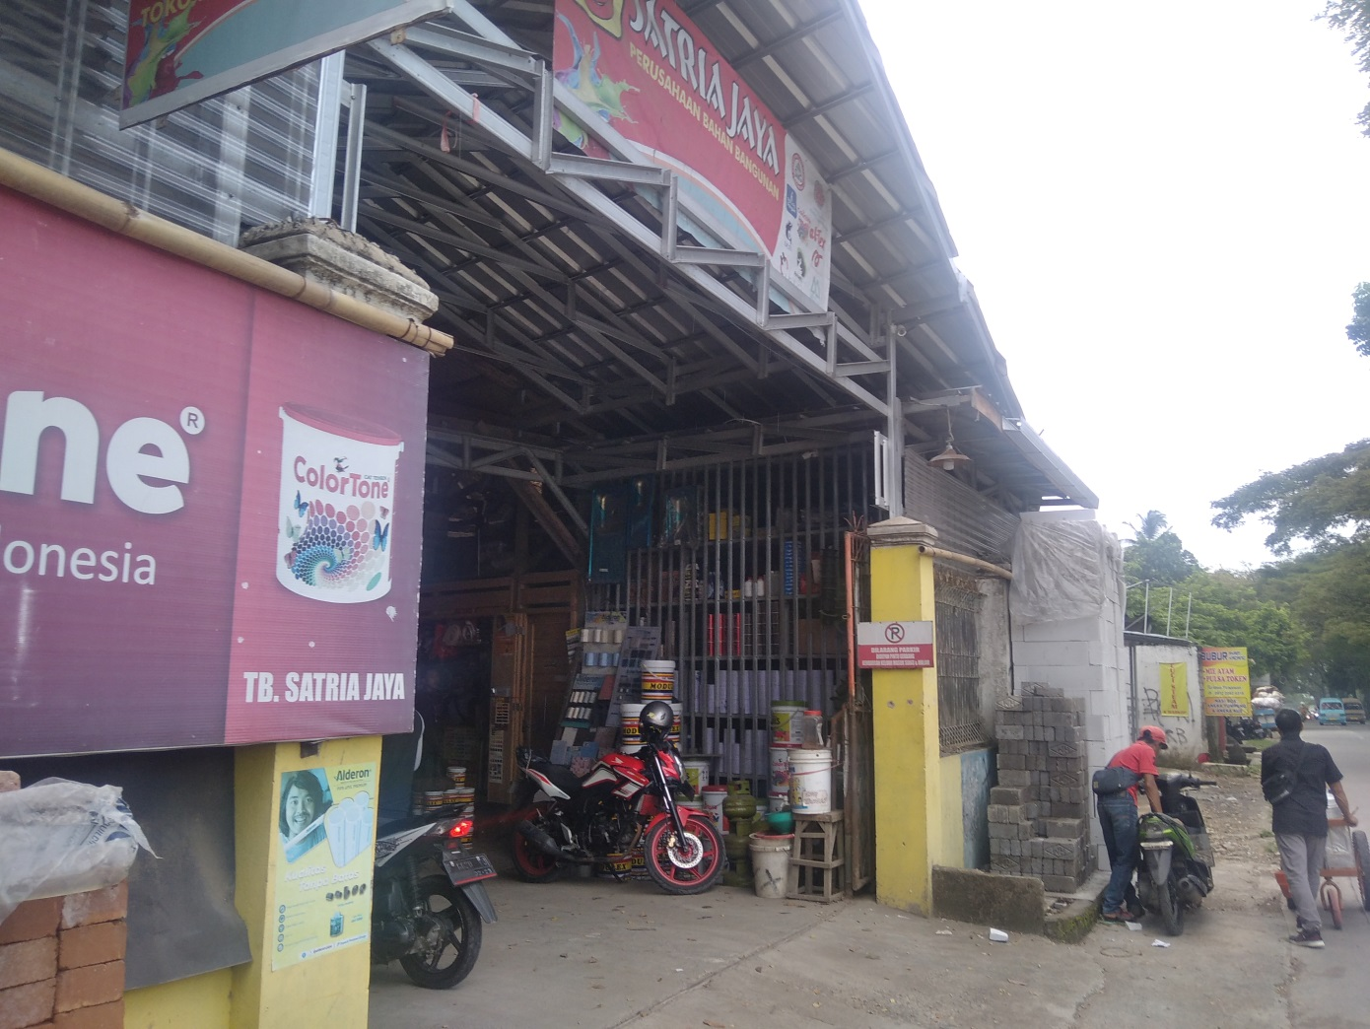
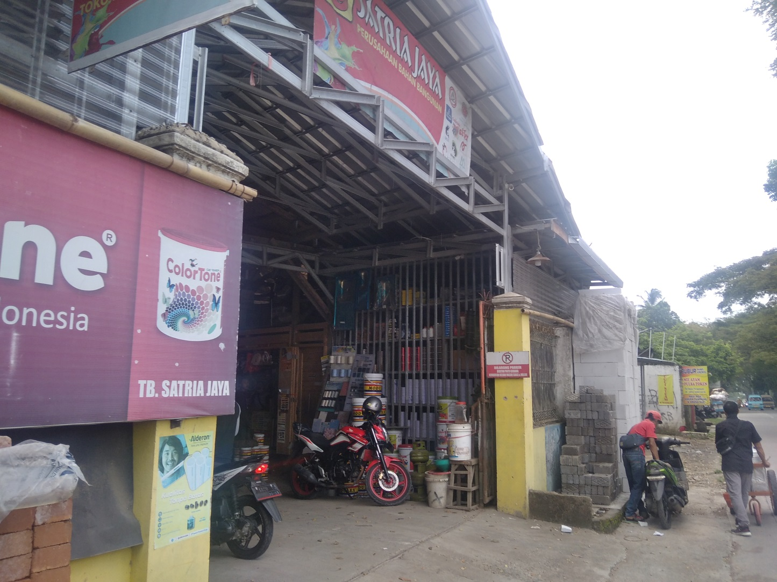
Maksud dan Tujuan
Maksud
Pembuatan aplikasi penjualan barang bahan bangunan (point of sale), ini dimaksudkan untuk membantu mengelola data barang, serta proses penjualan barang di Toko Bangunan Satria Jaya secara terkomputerisasi, yang saat ini masih menggunakan metode tulis tangan.
Aplikasi penjualan barang bahan bangunan (point of sale), ini diperlukan untuk mengelola data barang masuk, barang keluar, meminimalisir kehilangan data, serta proses penjualan terhadap konsumen secara tekomputerisasi.

Slide 7
Maksud dan Tujuan
Tujuan
Membuat sistem yang dapat mengelola barang masuk dan barang keluar, agar stock barang yang tersedia akan lebih mudah dipantau, dan dikendalikan.
Membuat sistem penjualan barang dengan komputerisasi, agar mempermudah proses penjualan terhadap konsumen.

Slide 8
l
Batasan Masalah
1. Pengelolaan data barang masuk
2. Pengelolaan data barang keluar
3. Cetak data penjualan barang, terhadap konsumen
Kembali

Slide 9
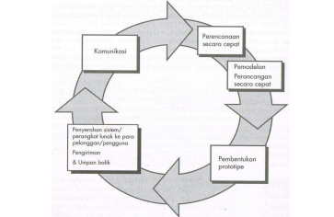
Metode Penelitian
Text
Easy to change colors, photos and Text.
1. Komunikasi
2. Perencanaan
3. Pemodelan
Text
Easy to change colors, photos and Text.
5. Konstruksi
6. Penyerahan
Text
Easy to change colors, photos and Text.

Slide 10

ANALISIS SISTEM YANG SEDANG BERJALAN
Pengelolaan Stock Barang
Proses Penjualan

Slide 11
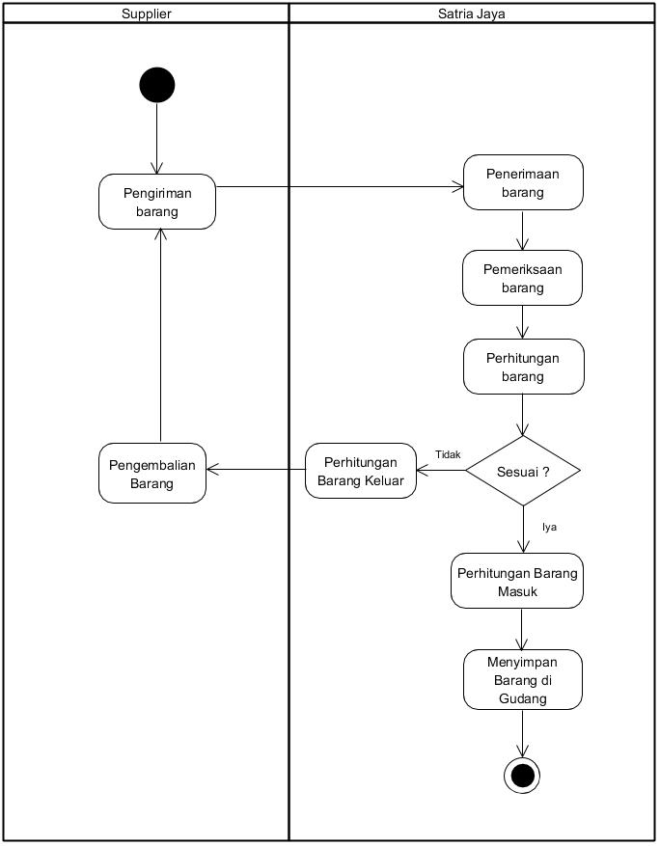
Worldmap Layout
Pengelolaan Stock Barang
Supplier melakukan pengiriman barang untuk Toko Satria Jaya
Toko Satria Jaya melakukan pemeriksaan atau pengecekan barang yang dikirim oleh supplier
Jika barang yang diterima sesuai (tidak terdapat cacat atau rusak), maka barang dihitung pada sebagai stock-in, jika barang yang diterima tidak sesuai, cacat atau rusak maka barang dihitung sebagai stock out dan dilakukan pengiriman kepada supplier
62K
Simple Presentation Designed
Get a modern PowerPoint Presentation that is beautifully designed. Easy to change colors, photos and Text. You can simply impress your audience and add a unique zing and appeal to your Presentations.

Slide 12
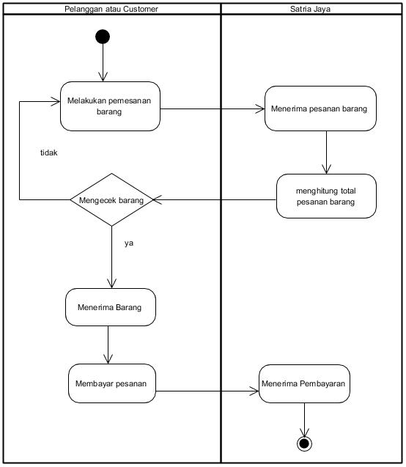
Worldmap Layout
Peroses penjualan
Customer atau pelanggan melakukan pesanan barang
Toko Satria Jaya menerima pesanan dan menghitung total pemesanan.
Customer atau pelanggan, mengecek barang yang di pesan, jika sesuai maka dilakukan pembayaran, jika tidak sesuai maka melakukan pesanan kembali barang.
Toko Satria Jaya menerima pembayaran
62K
Simple Presentation Designed
Get a modern PowerPoint Presentation that is beautifully designed. Easy to change colors, photos and Text. You can simply impress your audience and add a unique zing and appeal to your Presentations.
Kembali

Slide 13
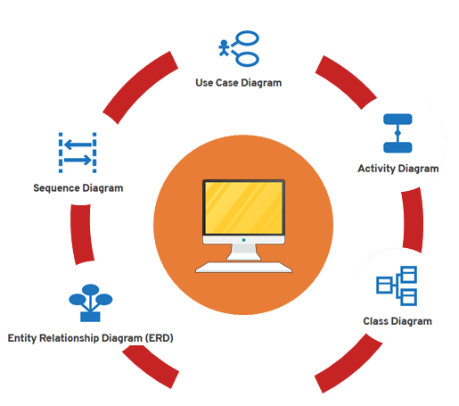
UML
Use case secenario
Use case diagram
Swimeline diagram
Class diagram
Sequance diagram
Entity Relationship Diagram ERD
Struktur Menu
Deployment Diagram
62K
Simple Presentation Designed
Get a modern PowerPoint Presentation that is beautifully designed. Easy to change colors, photos and Text. You can simply impress your audience and add a unique zing and appeal to your Presentations.

Slide 14
Worldmap Layout
Use case Scenario
62K
Simple Presentation Designed
Get a modern PowerPoint Presentation that is beautifully designed. Easy to change colors, photos and Text. You can simply impress your audience and add a unique zing and appeal to your Presentations.

Slide 15
Use case Scenario
62K
Simple Presentation Designed
Get a modern PowerPoint Presentation that is beautifully designed. Easy to change colors, photos and Text. You can simply impress your audience and add a unique zing and appeal to your Presentations.

Slide 16
Worldmap Layout
Use case Scenario
62K
Simple Presentation Designed
Get a modern PowerPoint Presentation that is beautifully designed. Easy to change colors, photos and Text. You can simply impress your audience and add a unique zing and appeal to your Presentations.

Slide 17
Worldmap Layout
Use case Scenario
62K
Simple Presentation Designed
Get a modern PowerPoint Presentation that is beautifully designed. Easy to change colors, photos and Text. You can simply impress your audience and add a unique zing and appeal to your Presentations.

Slide 18
Worldmap Layout
Use case Scenario
62K
Simple Presentation Designed
Get a modern PowerPoint Presentation that is beautifully designed. Easy to change colors, photos and Text. You can simply impress your audience and add a unique zing and appeal to your Presentations.

Slide 19
Use case Scenario
62K
Simple Presentation Designed
Get a modern PowerPoint Presentation that is beautifully designed. Easy to change colors, photos and Text. You can simply impress your audience and add a unique zing and appeal to your Presentations.

Slide 20
Worldmap Layout
Use case Scenario
62K
Simple Presentation Designed
Get a modern PowerPoint Presentation that is beautifully designed. Easy to change colors, photos and Text. You can simply impress your audience and add a unique zing and appeal to your Presentations.

Slide 21
Worldmap Layout
Use case Scenario
62K
Simple Presentation Designed
Get a modern PowerPoint Presentation that is beautifully designed. Easy to change colors, photos and Text. You can simply impress your audience and add a unique zing and appeal to your Presentations.

Slide 22
Worldmap Layout
Use case Scenario
62K
Simple Presentation Designed
Get a modern PowerPoint Presentation that is beautifully designed. Easy to change colors, photos and Text. You can simply impress your audience and add a unique zing and appeal to your Presentations.

Slide 23
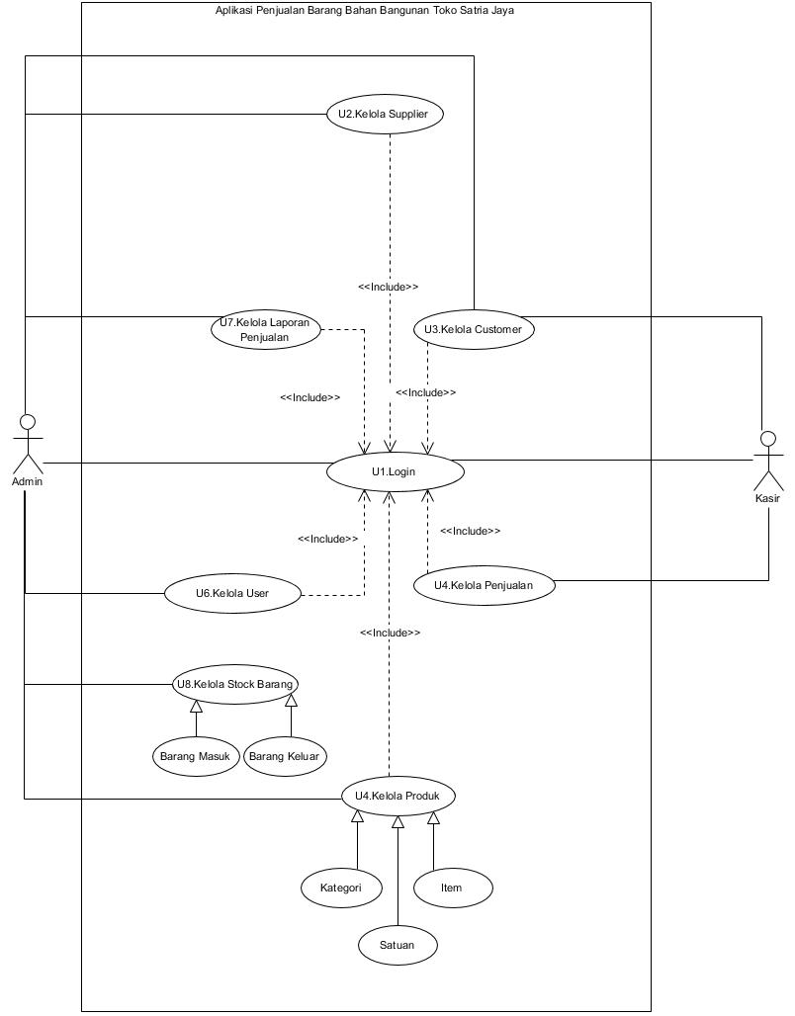
Worldmap Layout
Use case Diagram
62K
Simple Presentation Designed
Get a modern PowerPoint Presentation that is beautifully designed. Easy to change colors, photos and Text. You can simply impress your audience and add a unique zing and appeal to your Presentations.

Slide 24
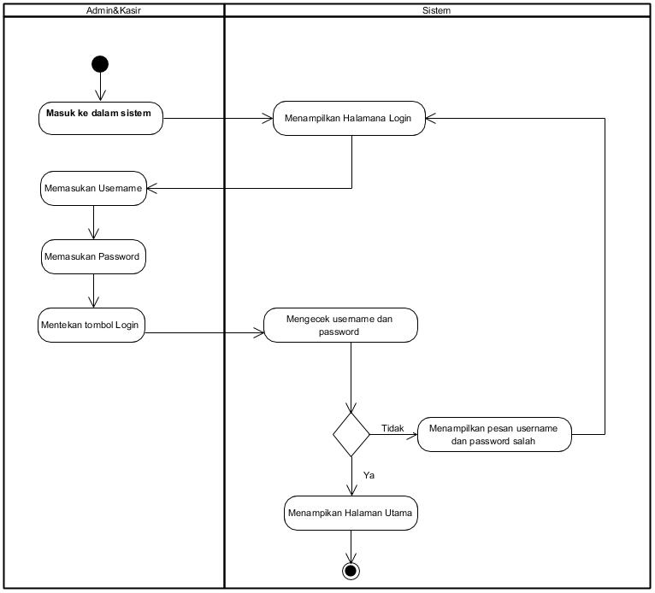
Worldmap Layout
Swimeline Diagram
62K
Simple Presentation Designed
Get a modern PowerPoint Presentation that is beautifully designed. Easy to change colors, photos and Text. You can simply impress your audience and add a unique zing and appeal to your Presentations.

Slide 25
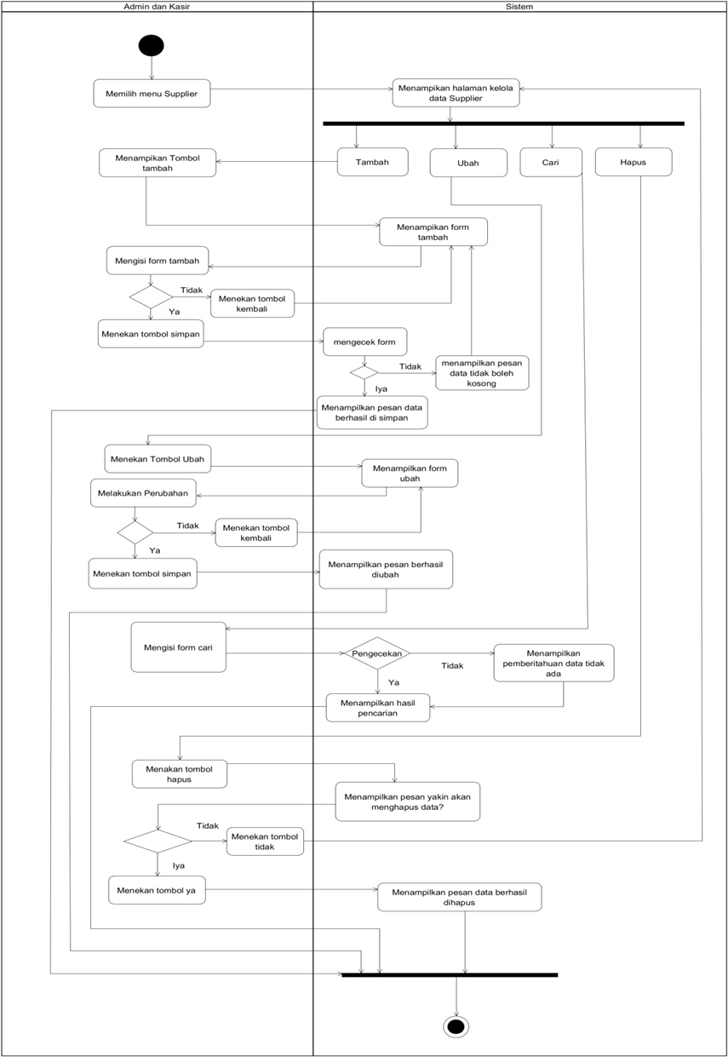
Worldmap Layout
Swimeline Diagram
62K
Simple Presentation Designed
Get a modern PowerPoint Presentation that is beautifully designed. Easy to change colors, photos and Text. You can simply impress your audience and add a unique zing and appeal to your Presentations.

Slide 26
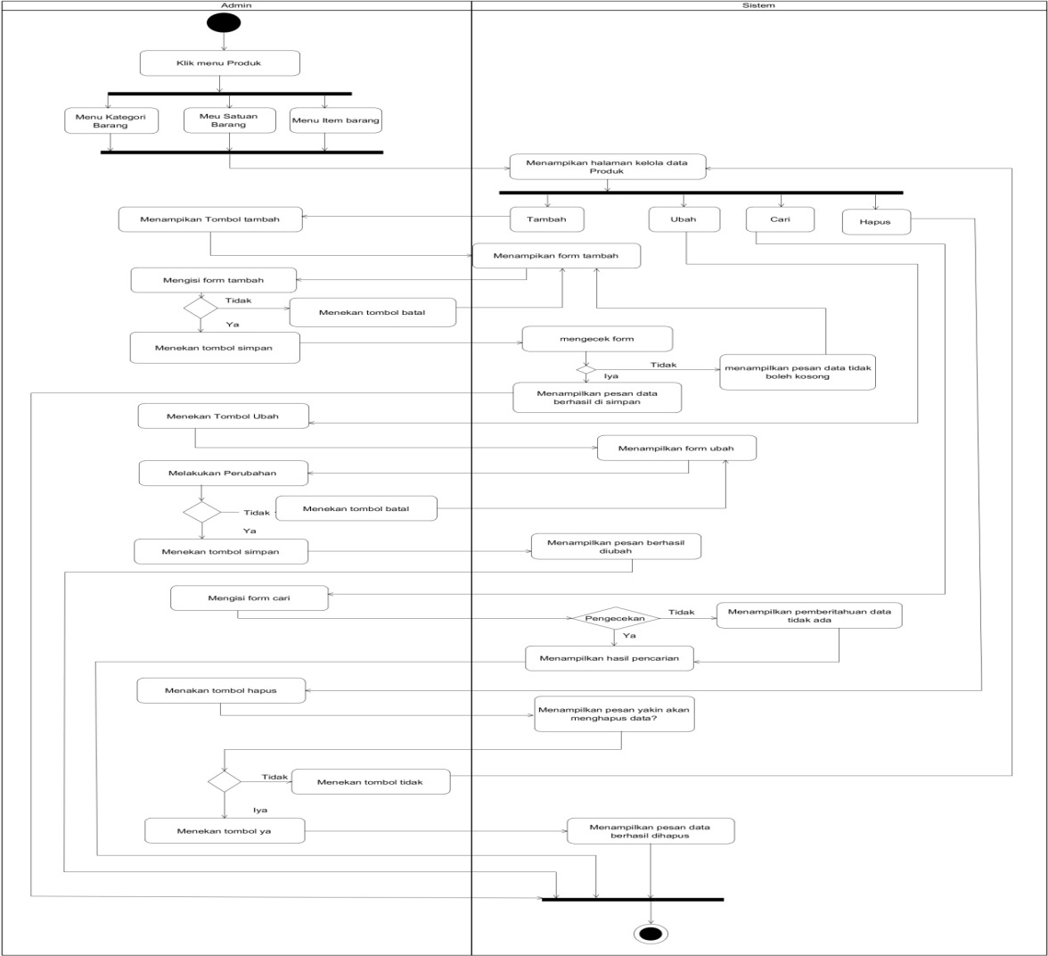
Swimeline Diagram
62K
Simple Presentation Designed
Get a modern PowerPoint Presentation that is beautifully designed. Easy to change colors, photos and Text. You can simply impress your audience and add a unique zing and appeal to your Presentations.

Slide 27
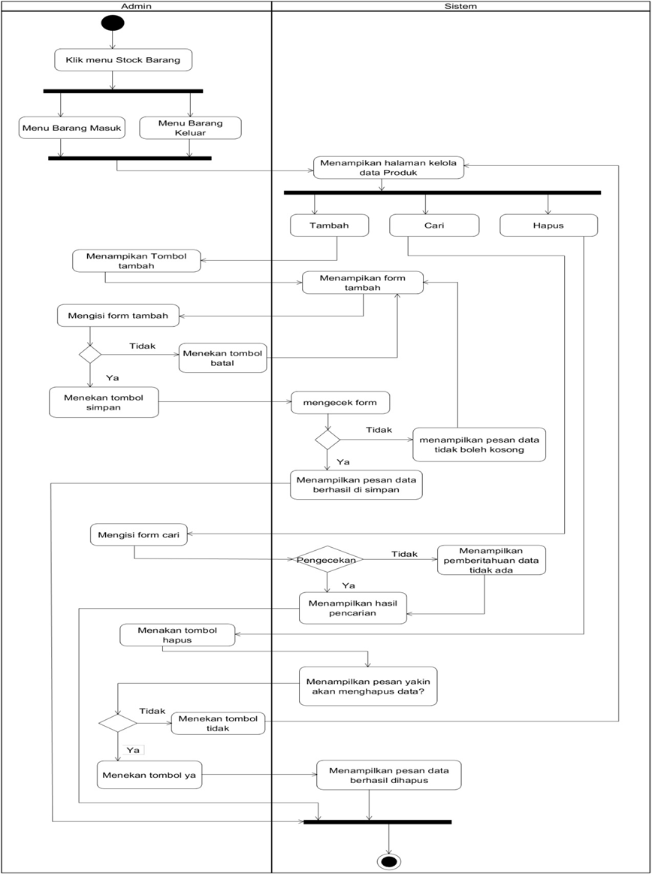
Worldmap Layout
Swimeline Diagram
62K
Simple Presentation Designed
Get a modern PowerPoint Presentation that is beautifully designed. Easy to change colors, photos and Text. You can simply impress your audience and add a unique zing and appeal to your Presentations.

Slide 28
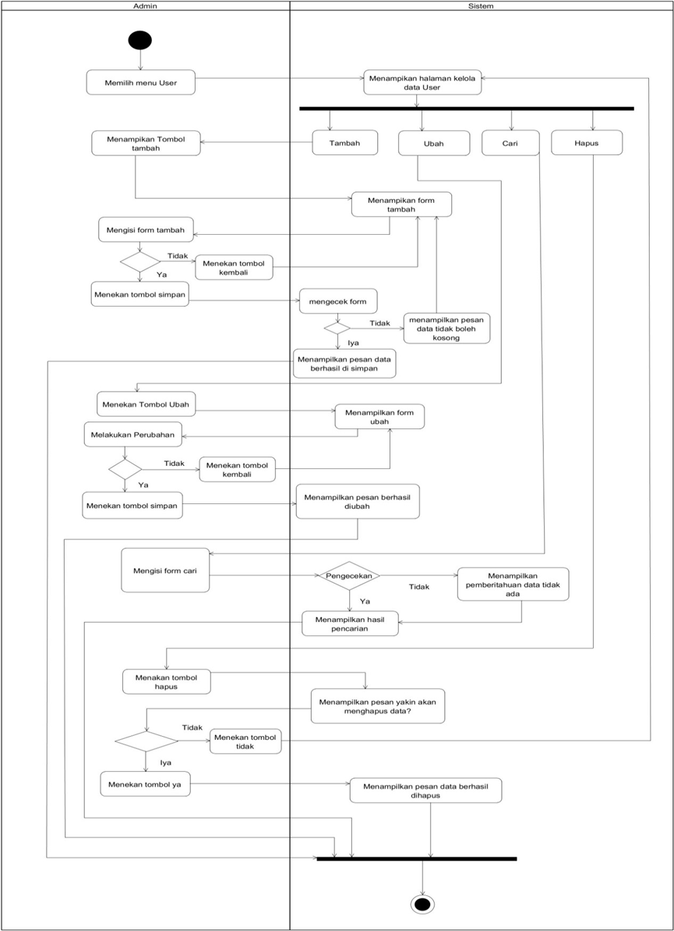
Worldmap Layout
Swimeline Diagram
62K
Simple Presentation Designed
Get a modern PowerPoint Presentation that is beautifully designed. Easy to change colors, photos and Text. You can simply impress your audience and add a unique zing and appeal to your Presentations.

Slide 29
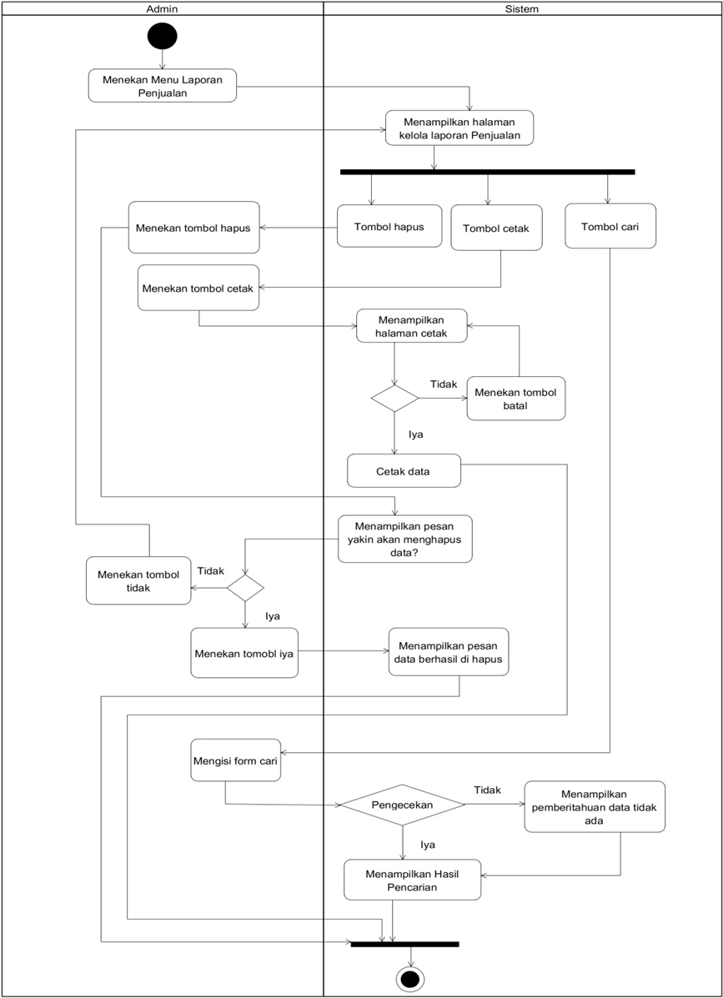
Worldmap Layout
Swimeline Diagram
62K
Simple Presentation Designed
Get a modern PowerPoint Presentation that is beautifully designed. Easy to change colors, photos and Text. You can simply impress your audience and add a unique zing and appeal to your Presentations.

Slide 30
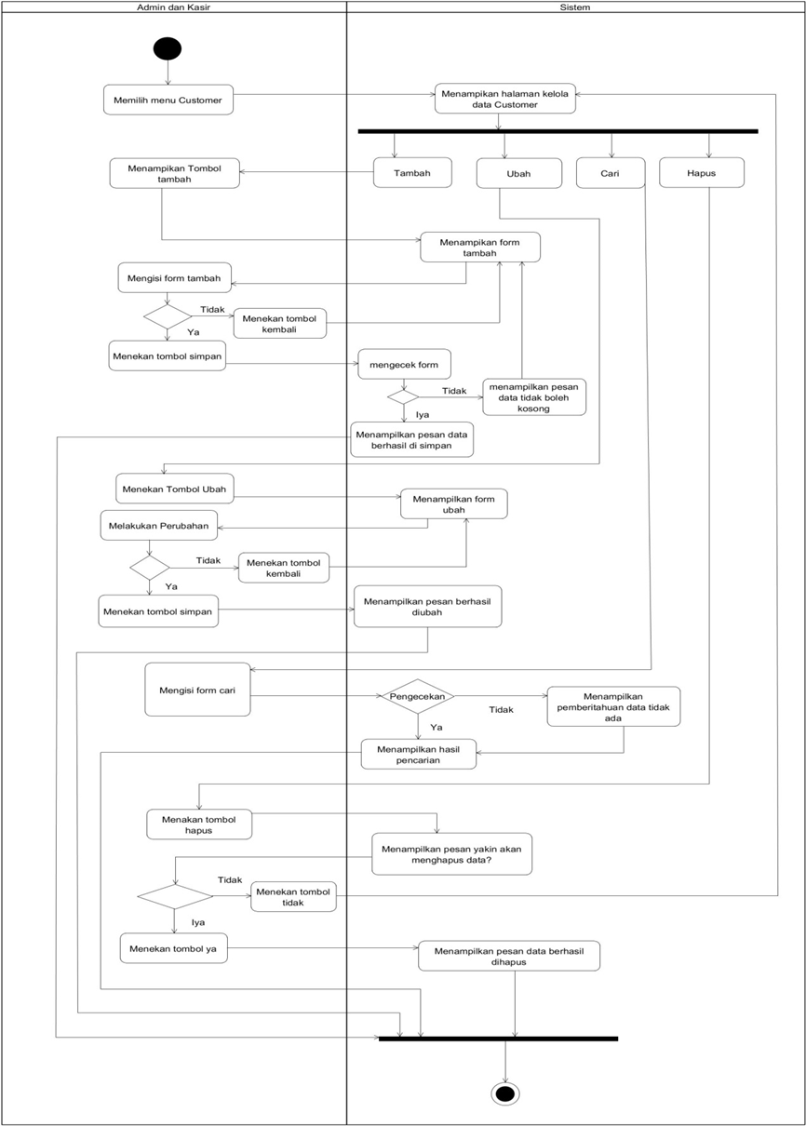
Worldmap Layout
Swimeline Diagram
62K
Simple Presentation Designed
Get a modern PowerPoint Presentation that is beautifully designed. Easy to change colors, photos and Text. You can simply impress your audience and add a unique zing and appeal to your Presentations.

Slide 31
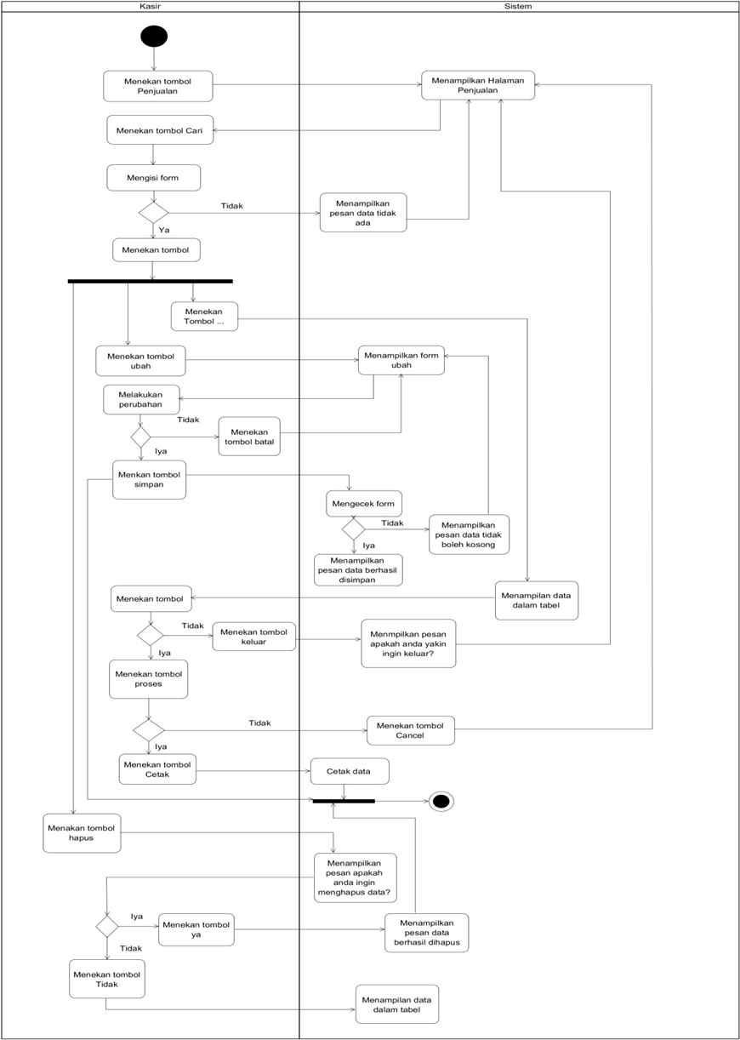
Worldmap Layout
Swimeline Diagram
Simple Presentation Designed
Get a modern PowerPoint Presentation that is beautifully designed. Easy to change colors, photos and Text. You can simply impress your audience and add a unique zing and appeal to your Presentations.

Slide 32
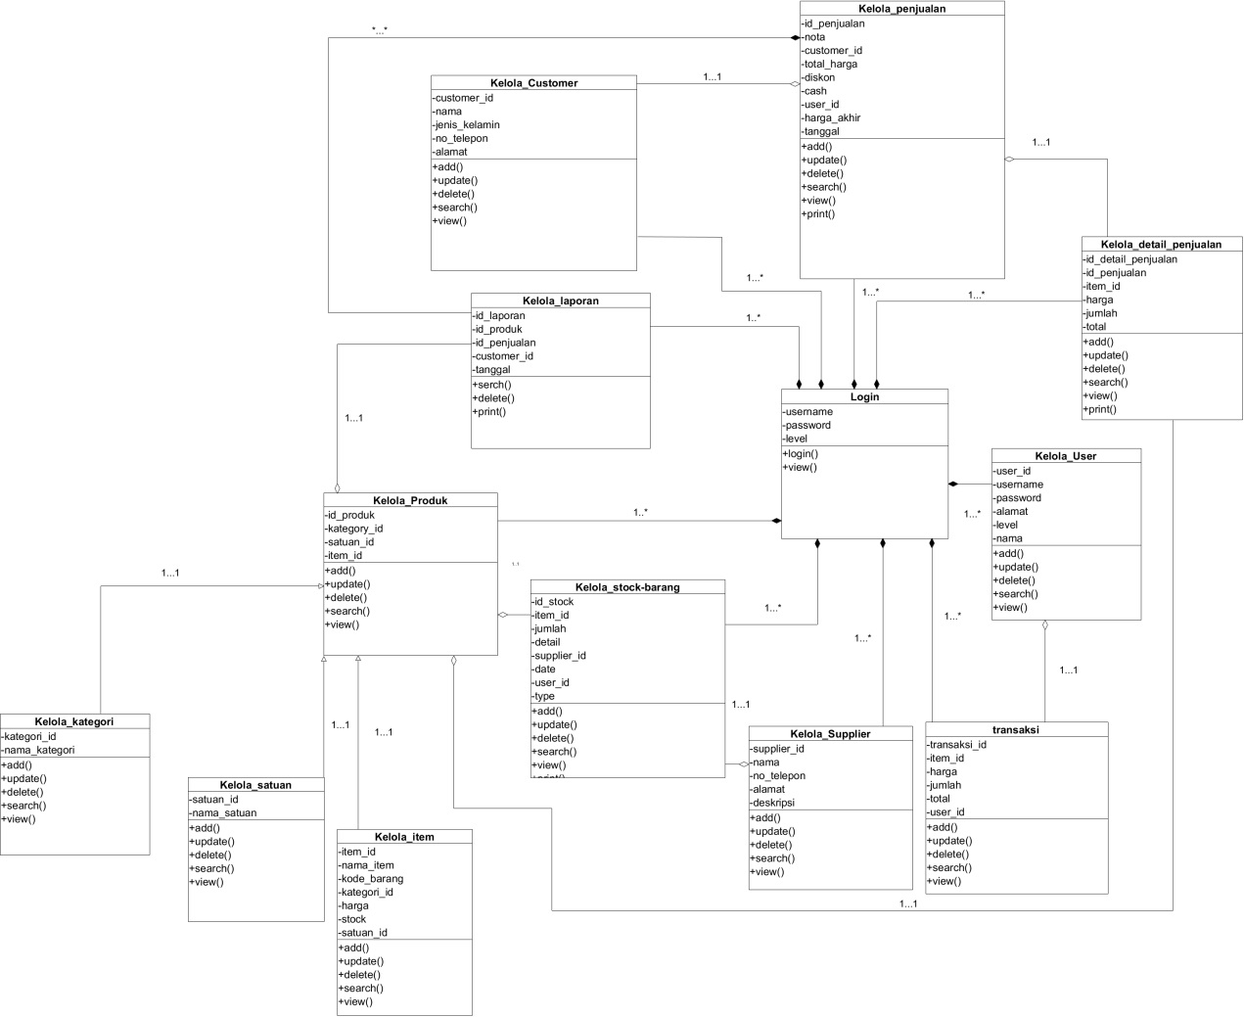
Class Diagram
62K
Simple Presentation Designed
Get a modern PowerPoint Presentation that is beautifully designed. Easy to change colors, photos and Text. You can simply impress your audience and add a unique zing and appeal to your Presentations.

Slide 33
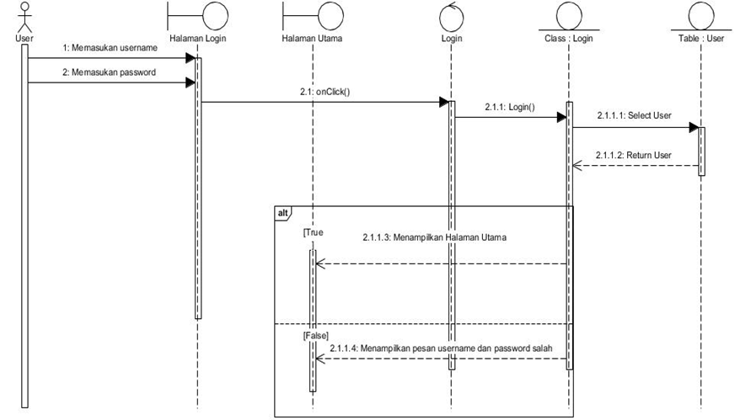
Sequance Diagram
62K
Simple Presentation Designed
Get a modern PowerPoint Presentation that is beautifully designed. Easy to change colors, photos and Text. You can simply impress your audience and add a unique zing and appeal to your Presentations.

Slide 34
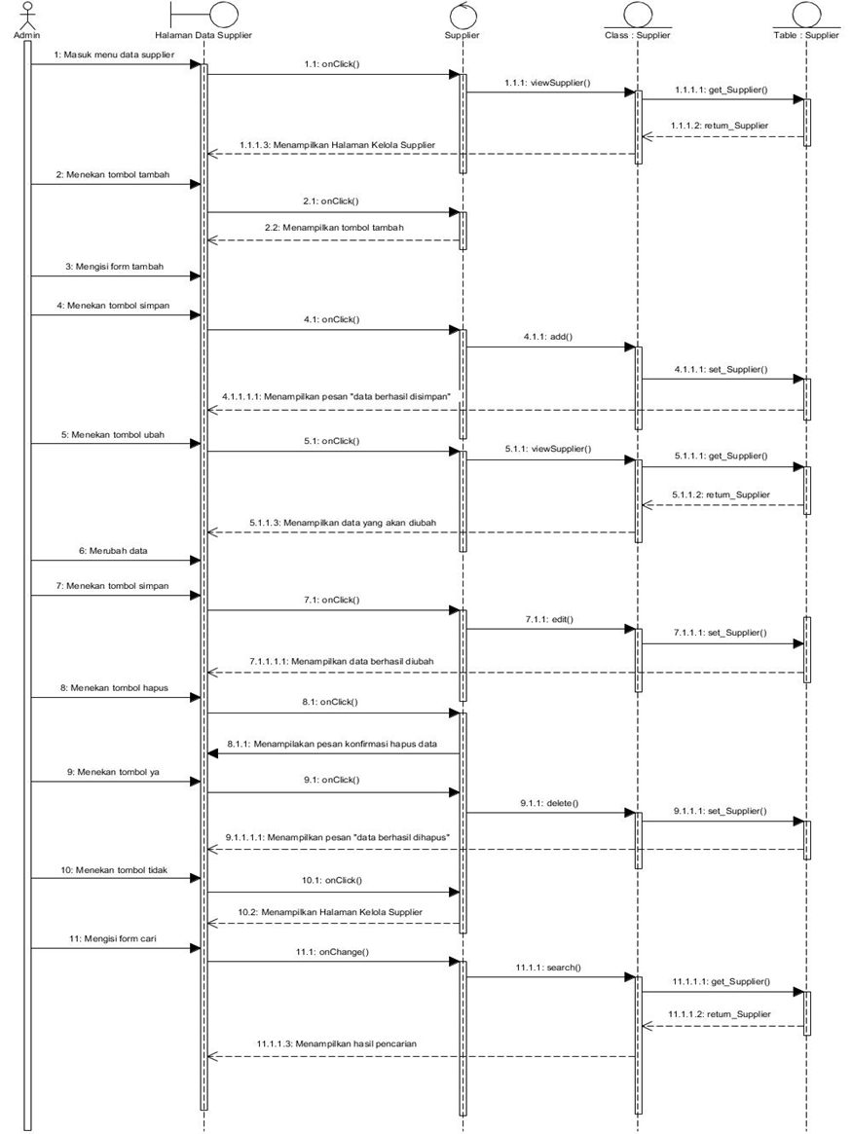
Sequance Diagram
62K
Simple Presentation Designed
Get a modern PowerPoint Presentation that is beautifully designed. Easy to change colors, photos and Text. You can simply impress your audience and add a unique zing and appeal to your Presentations.

Slide 35

Sequance Diagram
62K
Simple Presentation Designed
Get a modern PowerPoint Presentation that is beautifully designed. Easy to change colors, photos and Text. You can simply impress your audience and add a unique zing and appeal to your Presentations.

Slide 36
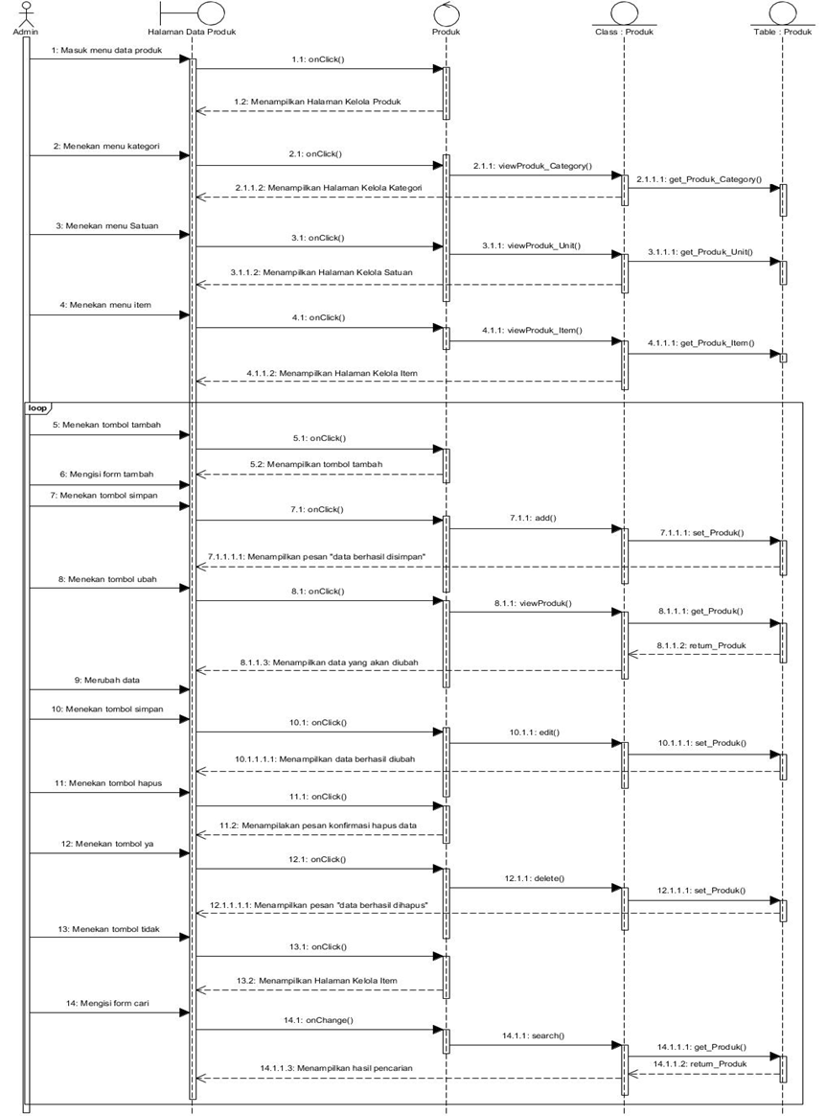
Sequance Diagram
62K
Simple Presentation Designed
Get a modern PowerPoint Presentation that is beautifully designed. Easy to change colors, photos and Text. You can simply impress your audience and add a unique zing and appeal to your Presentations.

Slide 37
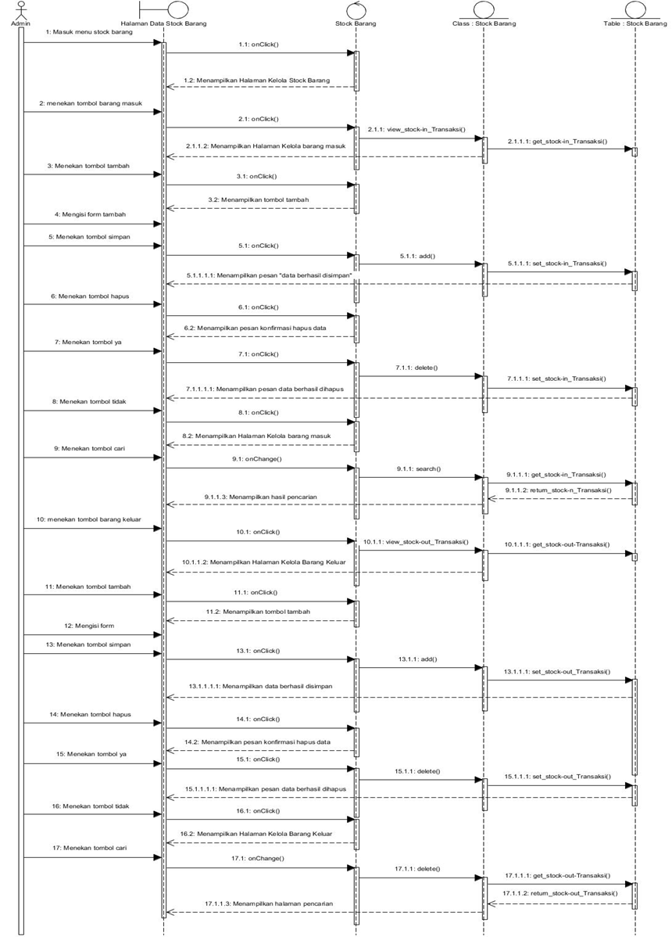
Sequance Diagram
62K
Simple Presentation Designed
Get a modern PowerPoint Presentation that is beautifully designed. Easy to change colors, photos and Text. You can simply impress your audience and add a unique zing and appeal to your Presentations.

Slide 38
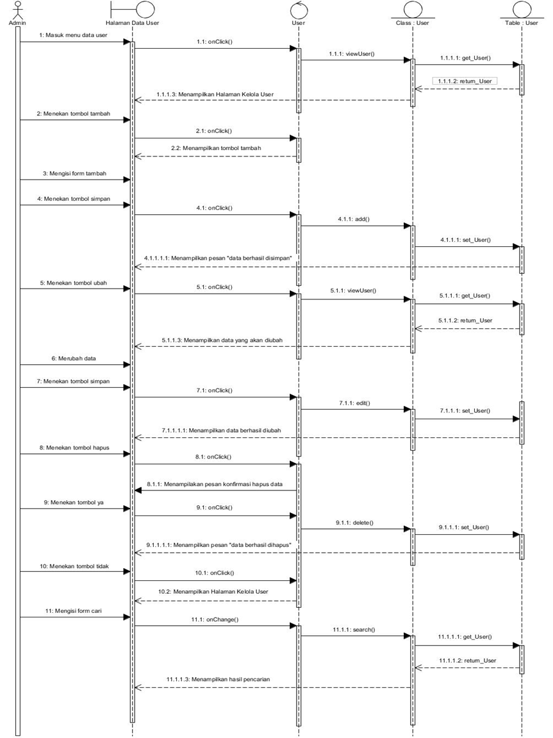
Sequance Diagram
62K
Simple Presentation Designed
Get a modern PowerPoint Presentation that is beautifully designed. Easy to change colors, photos and Text. You can simply impress your audience and add a unique zing and appeal to your Presentations.

Slide 39
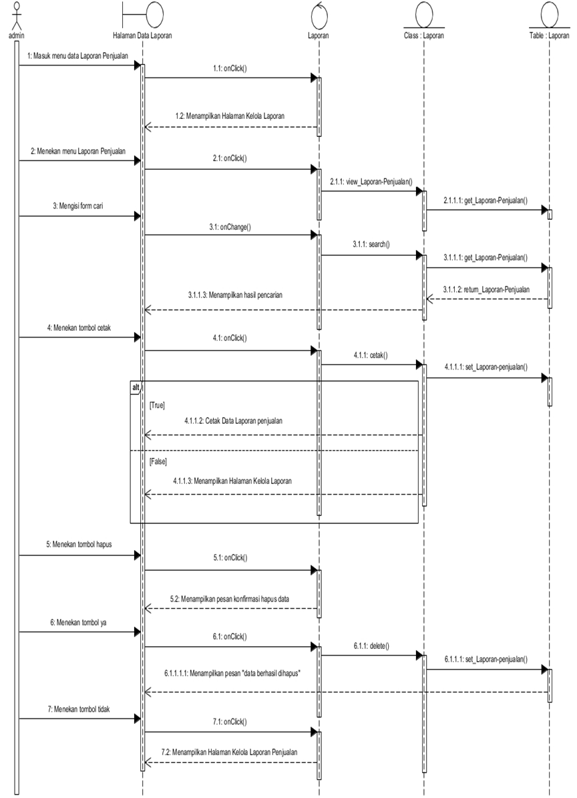
Sequance Diagram
62K
Simple Presentation Designed
Get a modern PowerPoint Presentation that is beautifully designed. Easy to change colors, photos and Text. You can simply impress your audience and add a unique zing and appeal to your Presentations.

Slide 40
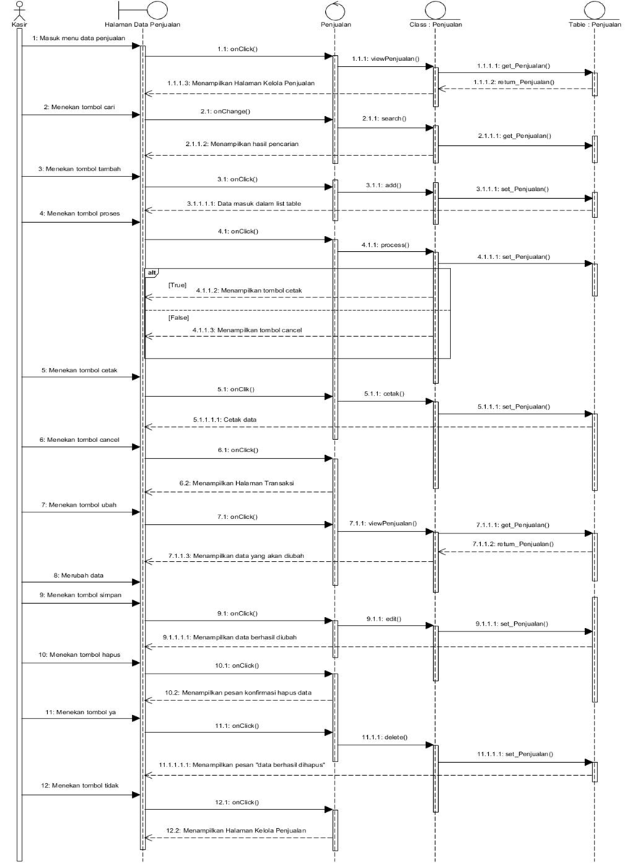
Sequance Diagram
62K
Simple Presentation Designed
Get a modern PowerPoint Presentation that is beautifully designed. Easy to change colors, photos and Text. You can simply impress your audience and add a unique zing and appeal to your Presentations.

Slide 41
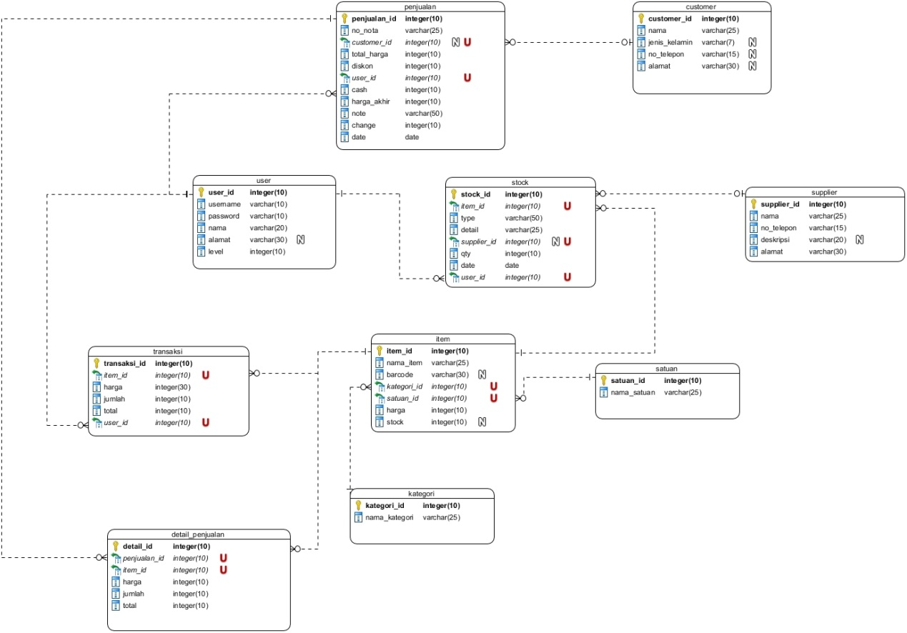
Worldmap Layout
Perancangan ERD (Entity Relationship Diagam)
62K
Simple Presentation Designed
Get a modern PowerPoint Presentation that is beautifully designed. Easy to change colors, photos and Text. You can simply impress your audience and add a unique zing and appeal to your Presentations.

Slide 42
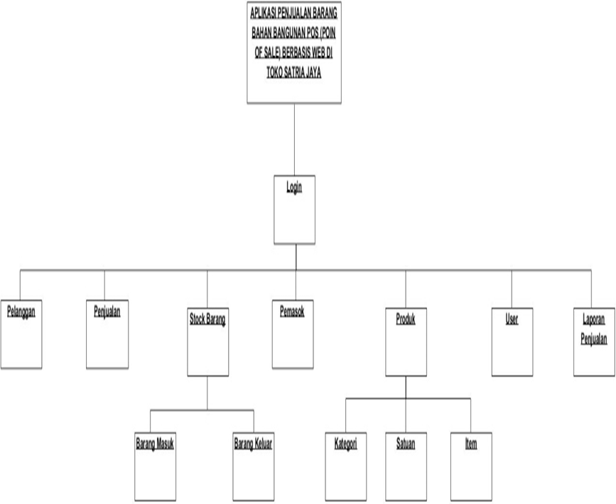
Worldmap Layout
Struktur Menu
62K
Simple Presentation Designed
Get a modern PowerPoint Presentation that is beautifully designed. Easy to change colors, photos and Text. You can simply impress your audience and add a unique zing and appeal to your Presentations.

Slide 43

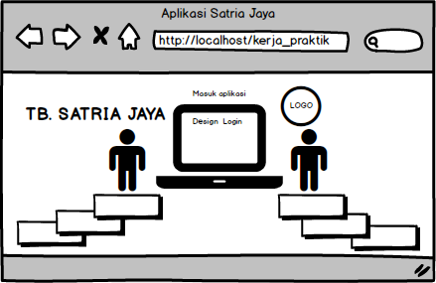


Perancangan Antarmuka (user Interface)
62K
Simple Presentation Designed

Slide 44
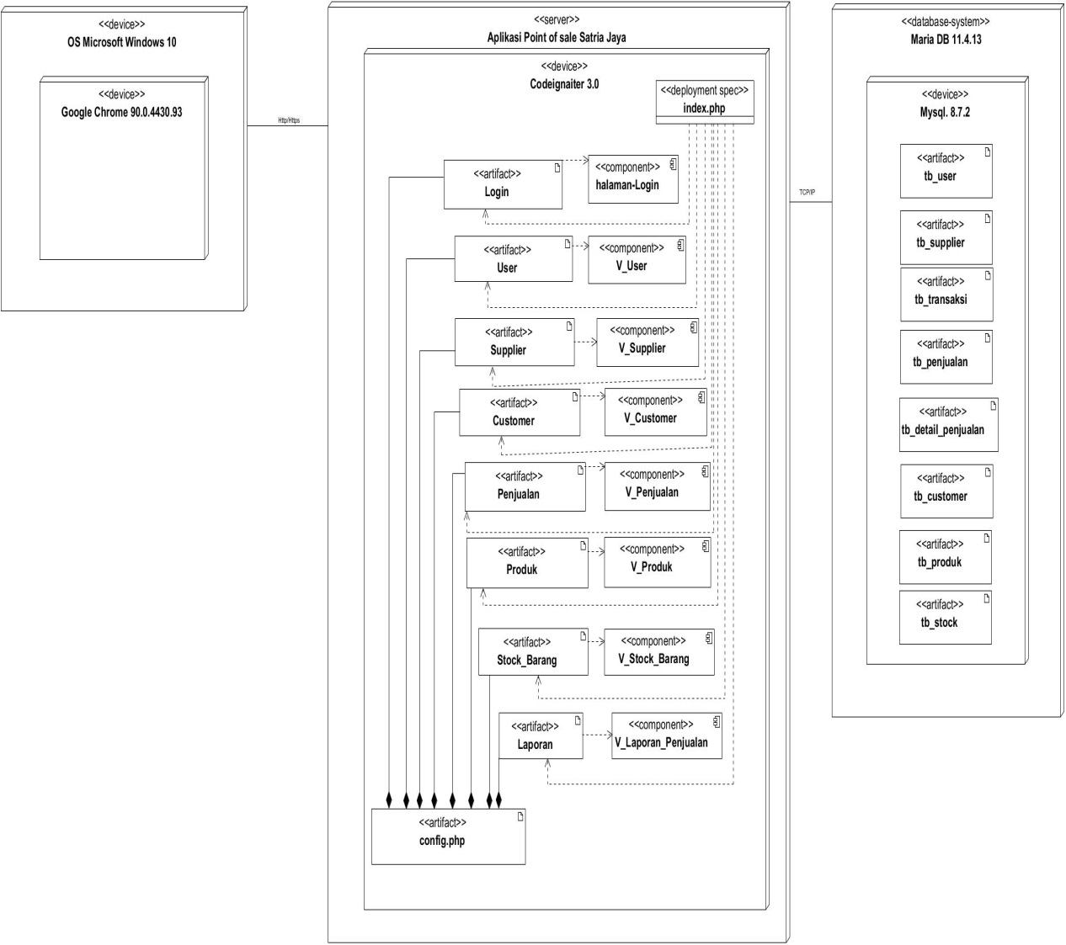
Worldmap Layout
Deployment Diagram
62K
Simple Presentation Designed
Get a modern PowerPoint Presentation that is beautifully designed. Easy to change colors, photos and Text. You can simply impress your audience and add a unique zing and appeal to your Presentations.
Kembali

Slide 45
Kesimpulan
TOKO SATRIA JAYA merupa suatu toko yang bergerak di bidang perdagangan,. Pada saat ini pencatatan data barang masuk dari supplier ataupun data barang keluar berupa return masih dicatat secara manual, begitu pun setiap transaksi penjualan terhadap konsumen dicatat secara manual,
1. Aplikasi ini dapat mengelola data barang masuk maupun keluar agar informasi yang dihasilkan akurat dan aktual.
2. Aplikasi ini dapat mengelola stock barang.
3. Aplikasi ini dapat membantu dalam transaksi secara komputerisasi.

Slide 46
Saran
Berdasarkan hasil analisis dan perancangan sistem yang telah dibuat maka penulis mengajukan beberapa saran kepada pihak yang akan mengembangkan sebagai pengembang aplikasi ini selanjutnya antara lain:
1. Aplikasi Point Of Sale ini dapat dikembangkan sesui perkembangan fungsional Toko Satria Jaya
2. Perlu adanya pemeliharaan dan pengembangan dari developer lain untuk mengembangkan aplikasi agar lebih baik dan bermanfaat untuk menunjang operasional kerja.
Kembali

